Slide 1
Legal Mitra [The consulting company]
Insights (IP Filing)
Abhishek Pratap Singh Arya
( Data Analyst )

Slide 2
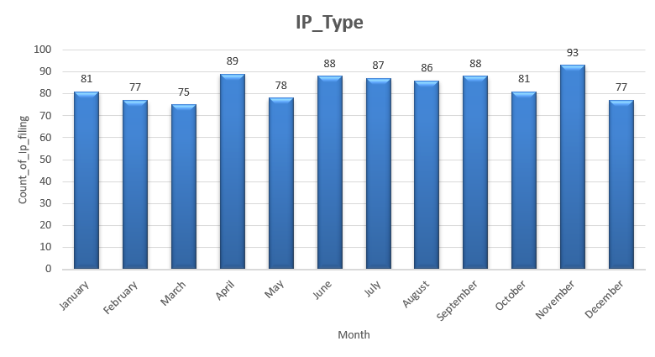
Month wise IP_Filing (2023 +2024)
Highest IP Filing :- November
Because they were finishing their targets and dealing with the year-end rush before the holidays.
Lowest IP Filing :- March
Many companies are busy in March because it’s the end of the fiscal year or they wait for the new fiscal year.

Slide 3
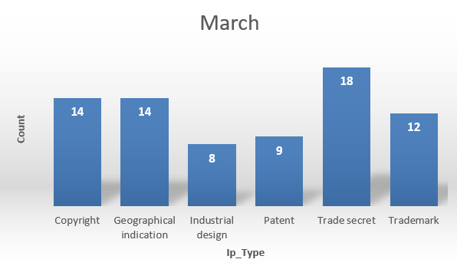
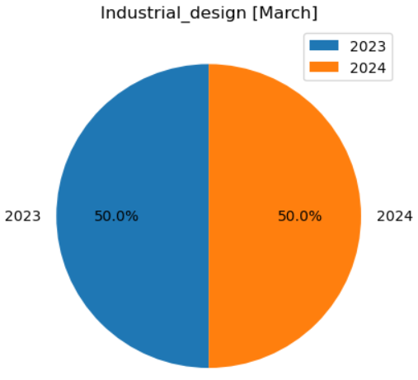
If we look at the data for March, Industrial Design is one of the IP types with the lowest number of filings.
When we look more closely at the Industrial Design data, we see that our company had zero growth in this sector.
However, according to the 2024 data, there was a 26% increase in IP filings across India.
Note: You should focus more on the Industrial Design sector during the month of March.

Slide 4
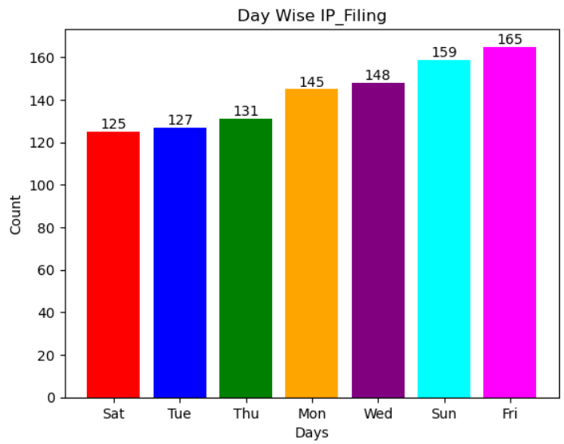
DAY WISE IP FILING 2023-24
Highest IP Filing Day : [Sunday and Friday]
I think this happens because many offices and companies are closed on Saturdays and Sundays. So, more IP filings are done on Fridays since it's the last working day before the weekend. Sunday comes in second place for IP filings, possibly because companies choose to file on holidays as well.
Lowest IP Filing Day : Saturday
Saturday has fewer IP filings. This is because in many places, Saturday is a government-declared holiday, so fewer filings are done on that day.

Slide 5
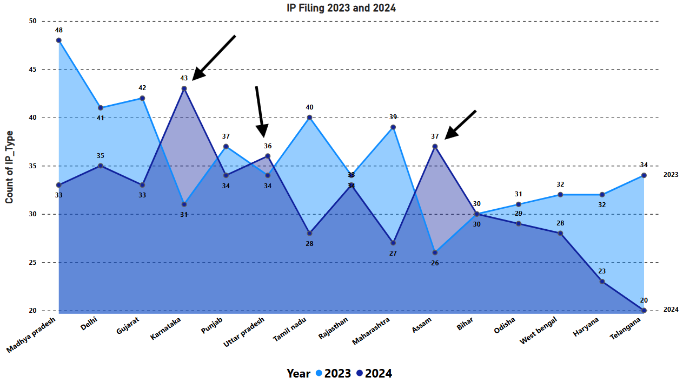
Karnataka, Uttar Pradesh, and Assam showed some growth in IP filings. In contrast, most other states saw a decrease compared to the previous year.

Slide 6
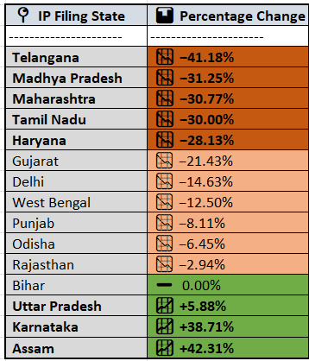
COMPARISON BETWEEN 2023 and 2024
Telangana, Madhya Pradesh, Maharashtra, Tamil Nadu, and Haryana experienced a significant drop in IP filings in India
INSIGHT :- Trademark declined sharply in 4 out of 5 states:
Telangana: − 80%
Madhya Pradesh: − 55.56%
Maharashtra: − 60%
Tamil Nadu: − 33.33%
Note:- Only in Haryana did it increase (+50%), helping
stabilize total filings there

Slide 7
If we move inside Telangana IP Filings:-
If we move inside Madhya Pradesh IP Filings:-
Note:- Trademark Decreased by 80% from previous year.
and copyright decreased by 60%.
Note:- Indrustrial Design Decreased by 58.33% from previous year.

Slide 8
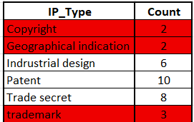
2024 IP_Type
In the month of September there is a big amount of IP filed in our company. While on May month the
Are shocking copyright , GI have only count of 2.
[ MAY ]

Slide 9
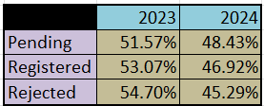
IP APPLICATION STATUS
Pending : Approx 36% of the IP Filing are pending out of 35 %
approx 51.57% are from 2023 and 48.43% are from 2024.
Registered : Approx 31% of the IP filing are Registered out of 31% 53.07% are from 2023 and 46.43% are
2024.
Rejected : Approx 34 % of the IP Filing are Rejected in which 54.70% are rejected in 2023 and 45.29% are
Rejected in 2024.

Slide 10
Registered IP_Filing Exp_year.
Year 2027 have highest amount of IP filing expiry so contact all of those companies in this year.

Slide 11
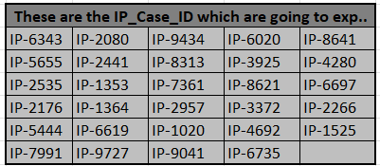
2025
September is the month of 2025 where Highest number of IP
Are going to expire so before that you can contact these
Companies before they reach other consulting company.
These are the Case IDs of the according to them find the
Name and ask them for their documents before they contact
Other consulting companies for IP.

Slide 12
2025
Saturday is the day in which most of the IP are going to expire on that day so before Saturday contact those
Companies and and ask for the documents for the Ip Filing. Saturday is the week off day at some govt.
Offices.

Slide 13
Rejection Reason [2023 and 2024]
Similarity is the reason behind the highest IP Filing rejection. To overcome this we can use an AI model which
Check Trademark and Patent of that company.

Slide 14
Income :- [ Enforcement cost ][Registered]
About 18% of income come from Trade Secret and copyright IP is one which give less income to the
Company.

Slide 15
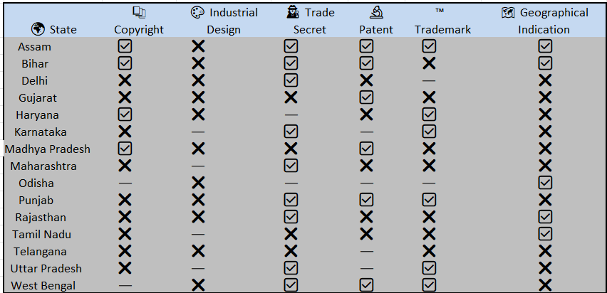










Growth Table :- Comparision between 2023-2024
---
As you see in previous slide Industrial design give High income to the company but in 2024, the condition of
This Ip filing is worst.Not a single state increase the number of filing from the previous year. Similar conditions
Are of Copyright and Geographical indication.

Slide 16
See Telangana ,Tamil nadu and Gujarat states are the worst performance state in 2024.
Odisha is the state which have less growth from the previous year.
Assam State performs well from the previous year.
Averages :-
This is the avg time taken by our company for IP Filing. When you approach other companies for IP filing then
You will show case these number .

Slide 17
Insights:- Geographical indication have highest approval rate (%) While Patent have very low Approval
rate

Slide 18
Forecast
This is the forecast sheet at 95% of confidence limit means the answer is 95% correct.
This sheet contains three trend line upper one is Upper confidence , middle one is Forecast, and lower is lower
Confidence bound ( Worst Case).

Slide 19
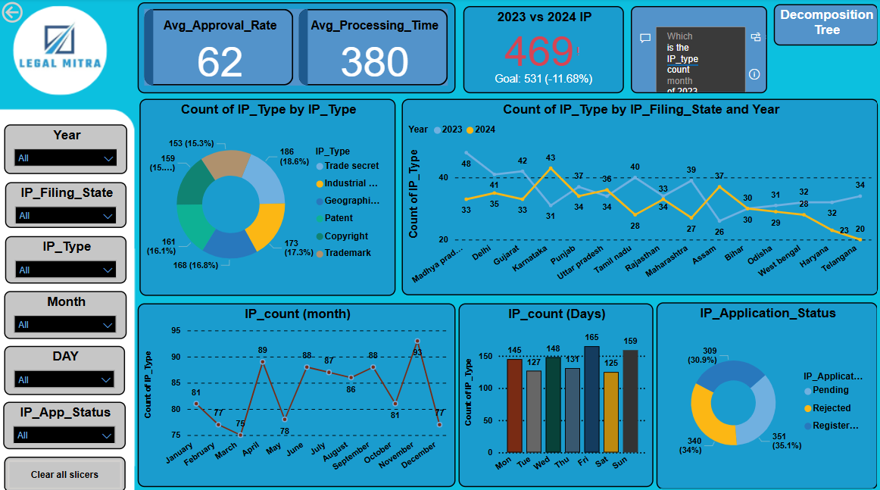

Slide 20
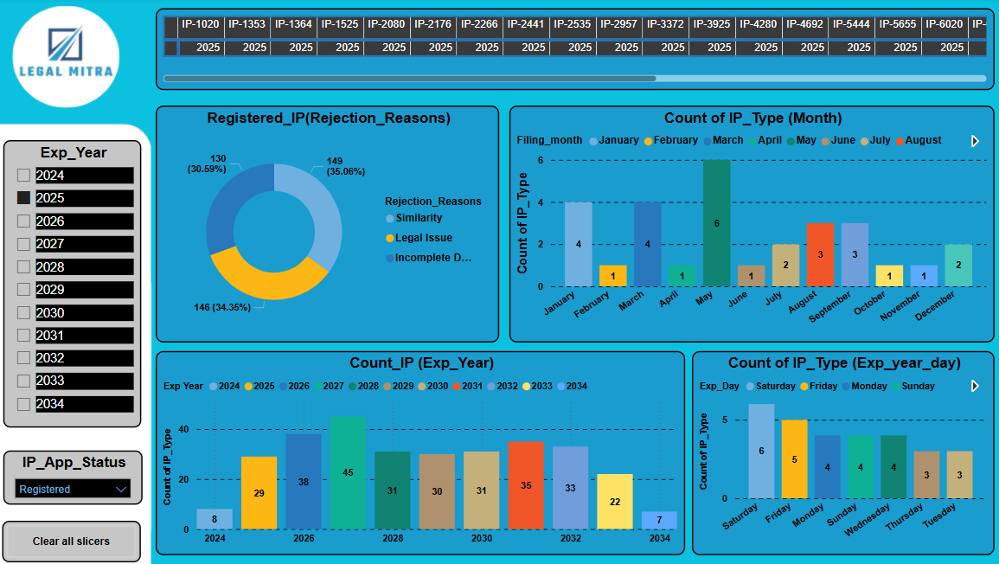

Slide 21
Thankyou…

